Slide 1
Customers with Complex Needs Somerset UC Ambassadors Meeting 27 July 2017
Jonathan Harris

Slide 2
Getting to a plan – evidence and consultation
Feedback: ICC; Partnership Managers; Stakeholders
Vulnerable Claimant Steering Group: Operations; OED; External Relations and Orientation; Housing Lead; Policy; Design; Strategic Design and Planning; Children Families and Disadvantaged
Evidence Sprint: Verification; Identification/Notification; Provision; Partnerships; Digital Exclusion
Design Spike: Operations; OED; External Relations and Orientation; ICC; Policy; Design; Test and Learn; Children Families and Disadvantaged
Transformation and Planning Group
Programme Delivery Executive

Slide 3
Our Main Priorities
Identifying, Recording and Acting on Complex Needs
Customers without Bank Accounts
Making and maintaining claims for those who will never successfully interact online
Appointees (personal and corporate)
Universal Support Delivered Locally

Slide 4
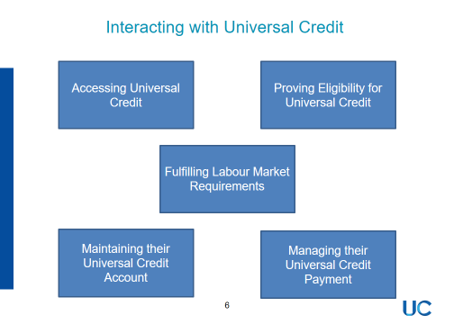
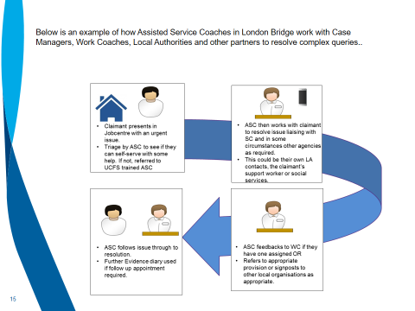
Identifying, Recording and Acting on Complex Need
Series of training sessions delivered across all jobcentres and service centres on identifying and acting on complex needs;
Site level complex needs plans;
Sharing of best practice nationally;
Audit and quality assurance.

Slide 5
Financial Exclusion….the unbanked
£1,300
1.71m
Ex-offenders
Homeless
Victims domestic abuse
Young people
Migrants
Refugees
Low income groups
Making Claim
Getting Paid
Opening Bank Account
85%

Slide 6
Routes into UC….where we can help
Jobcentres
Universal Support
Appointees
Visiting
Telephony
Triage
Maintenance

Slide 7
External Relations and Orientation
User testing of key messages with 600+ staff members and customers clarifying most commonly misunderstood messages - leading to production of ‘UC and You’
Next phase is to devise products that can be used alongside ‘UC and You’ by third parties to support vulnerable customers
Initially focus is on ex-offenders, care leavers, drug and alcohol addicts, victims of domestic violence and homeless customers
Over 50 organisations have been identified and meetings have started
Consultation will conclude at the end of July and products will then be tested before launch
UNIVERSAL
CREDIT
&
YOU

Slide 8
Conclusion
Recognition we need to do more to support vulnerable customers and those with complex needs
Right focus and range of initiatives to improve
Further evidence sprint and further measures until we get this right
Questions, comments and suggestions

