Slide 1
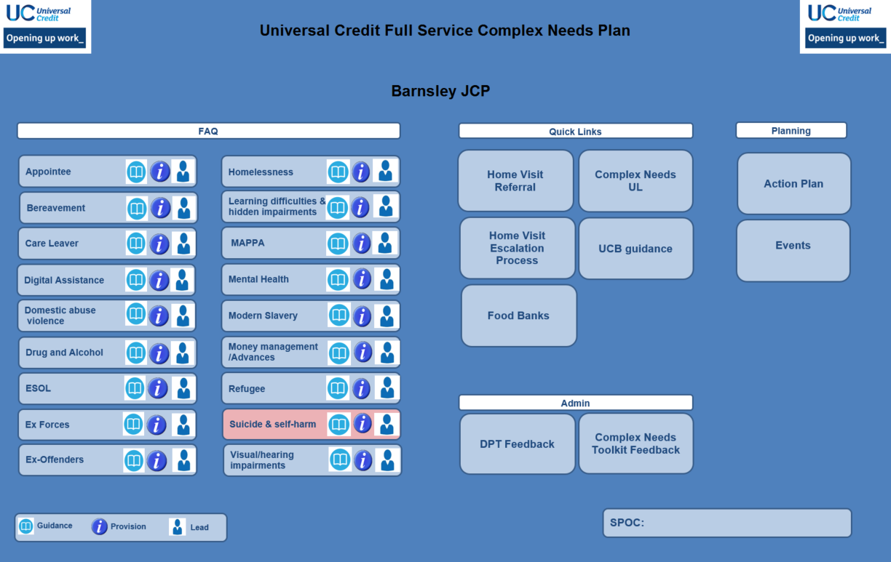
Complex Needs Toolkit
UC Health Design and Complex Needs Portfolio| UC Service Design & Transformation

Slide 2
Why do we need a standard toolkit
Ensure consistency and quality nationally.
Support service centres being able to access the information in the same way.
To reduce duplication and utilise existing products.
Notes:
Key messages
All toolkits should be converted onto the new standard excel template to ensure colleagues can find information efficiently and not have to navigate through different versions.
Sites need to make sure they are recording all information on the District Provision Tool. (DWP have given an assurance to Ministers that all DPTs are up to date and hold all the relevant information for signposting in that area)
As part of these changes, Service Centres will no longer be required to have their own, tailored toolkit. Instead, they will work closely with their linked Jobcentres and, as appropriate, contribute to site toolkits.

Slide 3
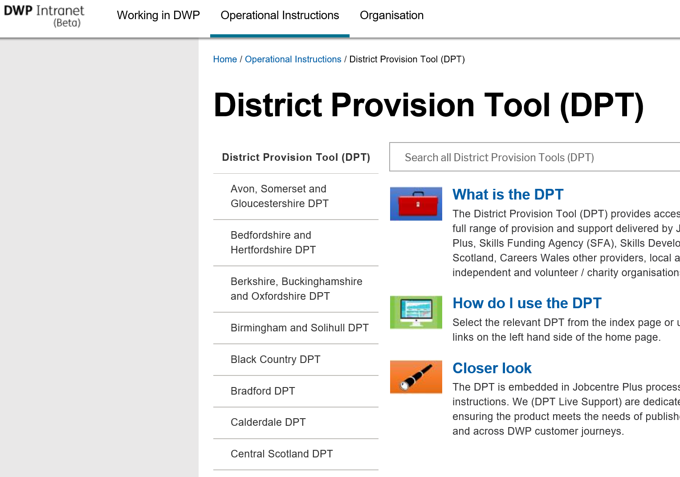
What goes on my DPT?
Everything to support work coaches in delivering provision, signposting and support.
In actuality you’ll find the DPT is more of a portal to everything; the sector pages linking to the National Employer Partnerships pages, the Specialist Support pages linking to national websites and the Vulnerability and Disadvantaged customers information etc. However, you should find all your district provision and support directly on the product.
As a user if you feel not everything is on that could, or should, be contact your district DPT publisher first
Notes:
Speaker Notes
As mentioned in the previous slide. As a Department we provide ministerial assurance that all our provision and support is recorded on the DPT .
There is a myth that the DPT is only used to record contracted and non contracted provision and to make 3rd party referrals but its not .
In fact the DPT is a portal to everything; the sector pages linking to the National Employer Partnerships pages, the Specialist Support pages linking to national websites and the Vulnerability and Disadvantaged customers information e.g. local charities, organisations, food banks etc..

Slide 4
A product for operational staff created by operational staff
OED collaborated with operational colleagues in the jobcentre and service centre network to design a product to enable staff to support claimants with complex needs.
The standard toolkit was tested within operations and has received fantastic feedback,
Colleagues from opp’s who had a chance to view a demonstration of the toolkit commented “were delighted that the product is going to be rolled out”
Notes:
Speaker Notes
OED SDT collaborated with operational colleague from both the jobcentre and service centre network to develop a standard product.
We listened to their insight and opinions and looked at existing versions that had already created.
Their plans were a lot more interactive, user-friendly and held useful information for colleagues in a front facing role.
We took sections of each plan to create a standard toolkit.
The new version is an interactive hub which signposts the user to all the necessary information required to support claimants with complex needs.
The Product has already been piloted in different areas. Feedback is excellent and the product has been well received.
We are currently working with colleagues in WA who are trialling the toolkit in one of their areas.

Slide 5
Toolkit walkthrough
Barnsley Complex Needs Toolkit
Notes:
The Home Page tab hosts information and provision for the main complex needs groups. This information can be tailored for the site. (talk through the icons)
The Events tab on the toolkit is designed to record all your local events and activities. This can include any up-skilling sessions, or partnership/community events. This information may be useful to your linked service centre and other sites, who may ask to attend and send a representative.
The Action Plan tab is designed to record any complex needs issues/gaps identified at your site and the actions you are taking to resolve them. This information may be useful to other sites who are experiencing similar issues. It can also be used as an audit trail of actions taken in your area to support claimants with complex needs.

Slide 6
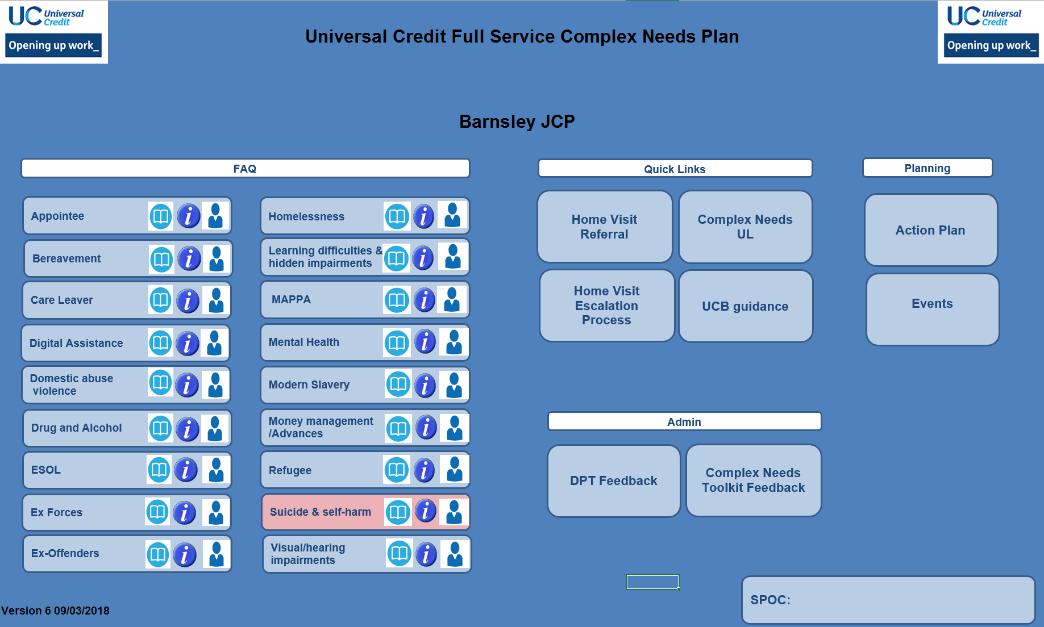
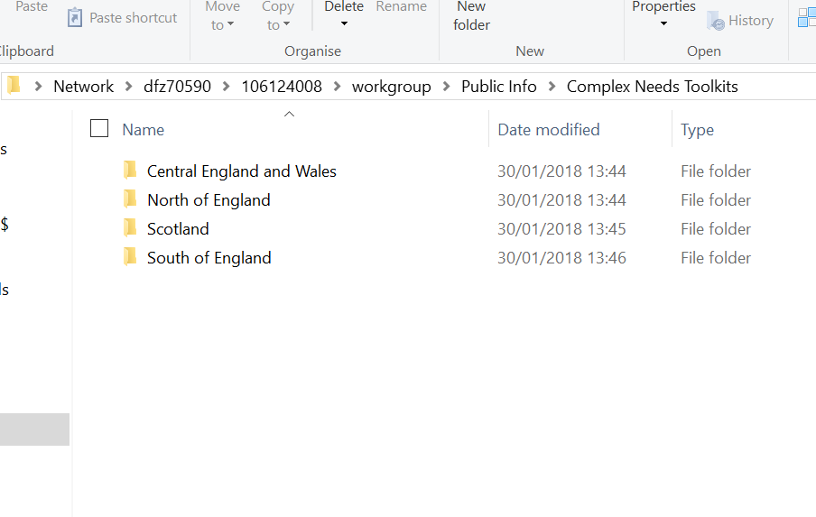
Governance
The OED UC Service Design & Transformation own the complex needs toolkit and its overall design.
If you would like us to consider any possible changes then you will need to complete a change request template and send to the dedicated inbox. All suggested/agreed changes will be communicated via the Complex Needs Social Intranet group.
A nominated jobcentre SPOC is responsible for maintaining the toolkit, for example adding hyperlinks to support/DPT, ensuring action points are progressed and the calendar is updated, regularly checking the social intranet group.
There is now a dedicated public shared folder to save all complex needs toolkits. This will allow colleagues from both jobcentres and service centres to access the plans that are relevant to them.
\\dfz70590\106124008\workgroup\Public Info\Complex Needs Toolkits\
Notes:
Key messages
We have designed a governance route and any Ideas or suggestions to improve to toolkit should be captured on the toolkit change request template and sent to the complex needs toolkit inbox:.
All agreed changes and any best practises will be communicated via the Complex Needs Social intranet group.
We advise that Sites appoint a nominated SPOC who will be responsible for maintaining the toolkit, adding hyperlinks to support/DPT, ensuring action points are progressed and the calendar is updated, regularly checking the social intranet group.
All Toolkits will be housed in a new Public Shared Folder which is organised by group and by district. We are aware that colleagues may not know which group or district a site belongs to so colleagues can search for a toolkit by putting the site name in the search field in the tool bar as they would in any shared folder.
FOI – Recently a number FOI request for the complex needs toolkit have been received. Whilst it is fine to share the toolkit, due to its nature of being a series of hyperlinks to the DPT, it wouldn’t work outside of the business. Best practice so far has been to invite third parties in to see it working in office.

Slide 7
Any Questions

